Slide 1

Chapter 4
Standards Battles, Modularity, and Platform competition
Strategic Management of Technological Innovation, 7th Edition
Melissa A. Schilling
© McGraw Hill LLC. All rights reserved. No reproduction or distribution without the prior written consent of McGraw Hill LLC.

Slide 2
Netflix and the Battle of the Streaming Services 1
By 2020, there were 1.1 billion subscribers to streaming services like Netflix, Hulu, Tencent Video, Disney, etc. Globally the overwhelming leader was Netflix with over 200 million subscribers in over 190 countries.
Streaming services could offer a much wider selection of content than physical stores, and offered additional services like reviews, recommender systems, movie trailers, etc.
By 2021, many streaming services were using their data on customer preferences to create original content tailored to particular market segments.
They also faced tough choices about making content exclusive: when companies made content exclusive to their channel, they were gambling that the boost in subscriptions would be worth more than wider distribution of that content – a tradeoff that was hard to calculate and predict.

Slide 3
Netflix and the Battle of the Streaming Services 2
Discussion Questions:
Based on your use of streaming services, do you feel the streaming platforms differ in terms of stand-alone value (For Example, fidelity, ease of use, recommender systems, etc.)?
Again based on your use, how do you feel the streaming services differ based on the types and quality of content they provide?
What factors do you think influence a consumer’s choice of whether to subscribe to a streaming service? How important are the standalone features? How important is the content?
What are the pros and cons of having content be exclusive to a service?
Do you think the market will eventually choose a few services as “winners” and the other services will exit (or combine with the winners) or will the market continue to support many different services?

Slide 4
Overview
Many industries experience strong pressure to select a single (or few) dominant design(s).
There are multiple dimensions shaping which technology rises to the position of the dominant design.
Firm strategies can influence several of these dimensions, enhancing the likelihood of their technologies rising to dominance.

Slide 5
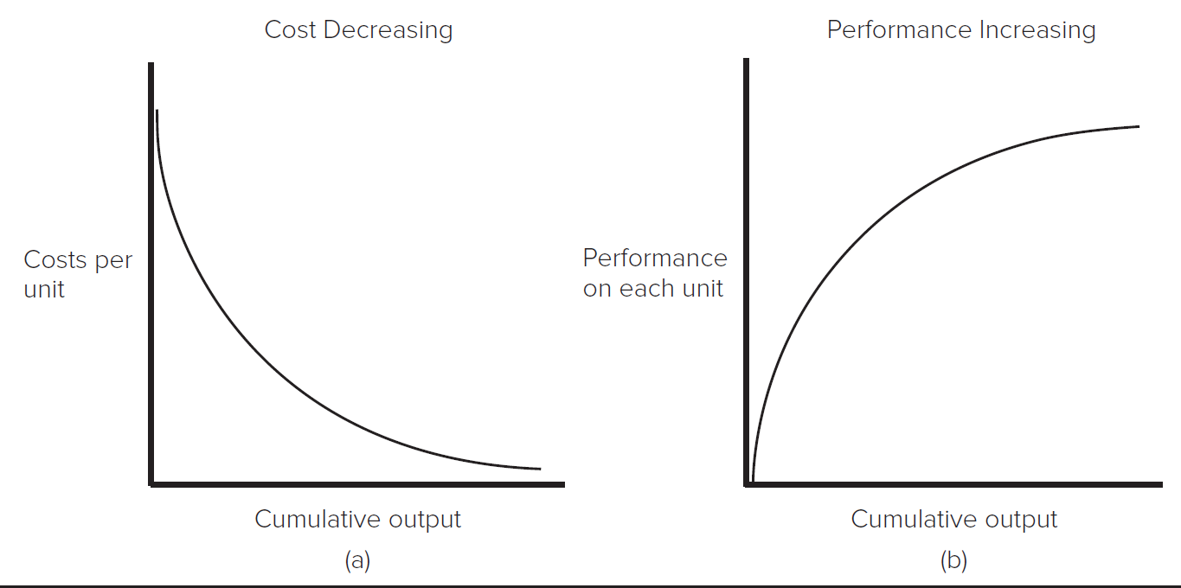
Why Dominant Designs Are Selected 1
Increasing returns to adoption
When a technology becomes more valuable the more it is adopted. Two primary sources are learning effects and network externalities.
The Learning Curve: As a technology is used, producers learn to make it more efficient and effective.
Access the text alternative for slide images.

Slide 6
Why Dominant Designs Are Selected 2
Prior Learning and Absorptive Capacity
A firm’s prior experience influences its ability to recognize and utilize new information.
Use of a particular technology builds knowledge base about that technology.
The knowledge base helps firms use and improve the technology.
Suggests that technologies adopted earlier than others are likely to become better developed, making it difficult for other technologies to catch up.

Slide 7
Why Dominant Designs Are Selected 3
Network Externalities
In markets with network externalities, the benefit from using a good increases with the number of other users of the same good.
Network externalities are common in industries that are physically networked.
For example, railroads, telecommunications.
Network externalities also arise when compatibility or complementary goods are important.
For example, Many people choose to use Windows in order to maximize the number of people their files are compatible with, and the range of software applications they can use.

Slide 8
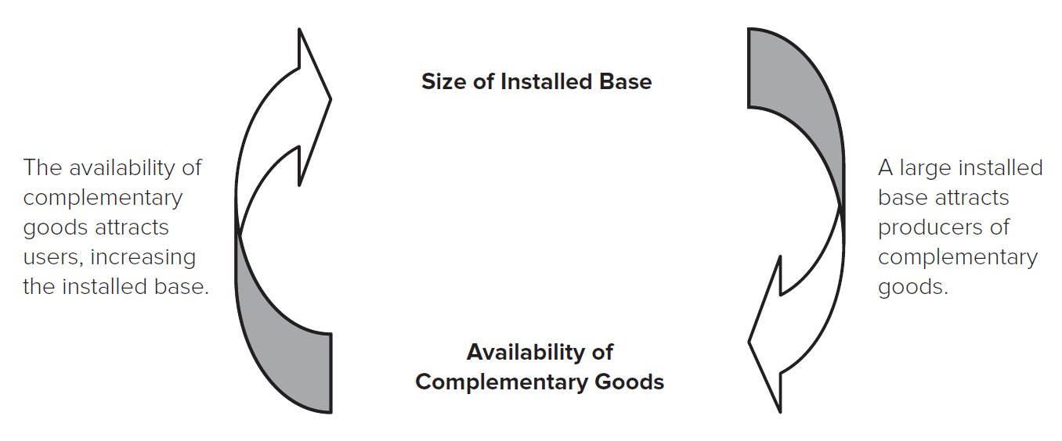
Why Dominant Designs Are Selected 4
A technology with a large installed base attracts developers of complementary goods; a technology with a wide range of complementary goods attracts users, increasing the installed base. A self-reinforcing cycle ensues:
Access the text alternative for slide images.

Slide 9
Theory In Action
The Rise of Microsoft
In 19 80, Microsoft didn’t even have a personal computer (P C) operating system – the dominant operating system was C P/M.
However, in I B M’s rush to bring a P C to market, they turned to Microsoft for an operating system and Microsoft produced a clone of C P/M called “M S D O S.”
The success of the I B M P Cs (and clones of I B M P Cs) resulted in the rapid spread of M S D O S, and an even more rapid proliferation of software applications designed to run on M S D O S. Microsoft’s Windows was later bundled with (and eventually replaced) M S D O S.
Had Gary Kildall signed with I B M, or had other companies not been able to clone the I B M P C, the software industry might look very different today!

Slide 10
Why Dominant Designs Are Selected 5
Government Regulation
Sometimes the consumer welfare benefits of having a single dominant design prompts government organizations to intervene, imposing a standard.
For example, the N T S C color standard in television broadcasting in the U.S.; the general standard for mobile communications (G S M) in the European Union.
The Result: Winner-Take-All Markets
Natural monopolies.
Firms supporting winning technologies earn huge rewards; others may be locked out.

Slide 11
Why Dominant Designs Are Selected 6
Increasing returns indicate that technology trajectories are characterized by path dependency:
End results depend greatly on the events that took place leading up to the outcome.
A dominant design can have far-reaching influence; it shapes future technological inquiry in the area.
Winner-take-all markets can have very different competitive dynamics than other markets.
Technologically superior products do not always win.
Such markets require different firm strategies for success than markets with less pressure for a single dominant design.

Slide 12
Multiple Dimensions of Value 1
In many increasing returns industries, the value of a technology is strongly influenced by both:
Technology’s Standalone Value.
Network Externality Value.
A Technology’s Stand-alone Value.
Includes such factors as:
The functions the technology enables customers to perform.
Its aesthetic qualities.
Its ease of use, etc.

Slide 13
Multiple Dimensions of Value 2
Kim and Mauborgne developed a “Buyer Utility Map” that is useful for identifying elements of a technology’s stand-alone value:
 | Purchase | Delivery | Use | Supplements | Maintenance | Disposal
Customer productivity | Price of Prius slightly higher than comparable nonhybrid models |  | Offers speed and power comparable to nonhybrid models | Can stop less often for gas, saving money and time | N A | N A
Simplicity | Buyer may feel less able to assess value of vehicle | N A | Operates like a regular combustion engine vehicle | Refuels like a regular combustion engine vehicle | N A | Hybrids have larger batteries that would have to be recycled and disposed of at end of life
Source: Adapted from Harvard Business Review. Exhibit from “Knowing a Winning Business Idea When You See One,” by W. C. Kim and R. Mauborgne, September– October 2000.

Slide 14
Multiple Dimensions of Value 3
 | Purchase | Delivery | Use | Supplements | Maintenance | Disposal
Convenience | N A | Will be sold through traditional dealer channels | Does not have to be plugged into electrical outlet | Can purchase fuel at regular gas stations | Maintenance is similar to regular combustion engine vehicle | N A
Risk | N A | N A | Buyer might face a higher risk of product failure because it embodies a new technology | N A | Buyer might have difficulty finding replacement parts because of new technology | Prius might be more difficult to resell or have lower resell value
Source: Adapted from Harvard Business Review. Exhibit from “Knowing a Winning Business Idea When You See One,” by W. C. Kim and R. Mauborgne, September– October 2000.

Slide 15
Multiple Dimensions of Value 4
 | Purchase | Delivery | Use | Supplements | Maintenance | Disposal
Fun and image | N A | Connotes image of environmental responsibility | N A | N A | N A | N A
Environmental friendliness | Buyers feel they are helping support the development of more environmentally friendly cars | N A | Emits lower levels of pollutants | Requires less use of fossil fuels | N A | N A
Source: Adapted from Harvard Business Review. Exhibit from “Knowing a Winning Business Idea When You See One,” by W. C. Kim and R. Mauborgne, September– October 2000.

Slide 16
Multiple Dimensions of Value 5
Network Externality Value
Includes the value created by:
The size of the technology’s installed base.
The availability of complementary goods.
A new technology that has significantly more standalone functionality than the incumbent technology may offer less overall value because it has a smaller installed base or poor availability of complementary goods.
For example, NeXT Computers were extremely advanced technologically, but could not compete with the installed base value and complementary good value of Windows-based personal computers.

Slide 17
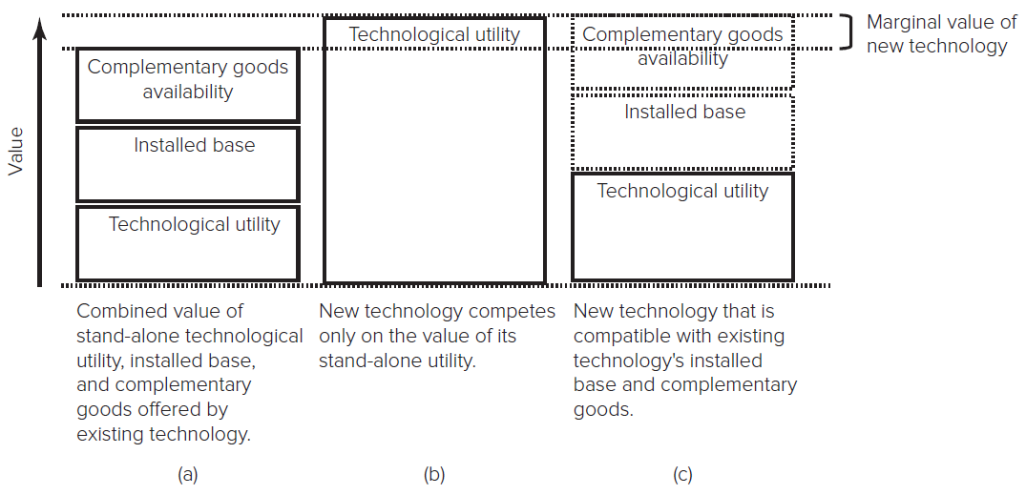
Multiple Dimensions of Value 6
To successfully overthrow an existing dominant technology, new technology often must either offer:
Dramatic technological improvement (for example, in videogame consoles, it has taken 3X performance of incumbent).
Compatibility with existing installed base and complements.
Access the text alternative for slide images.

Slide 18
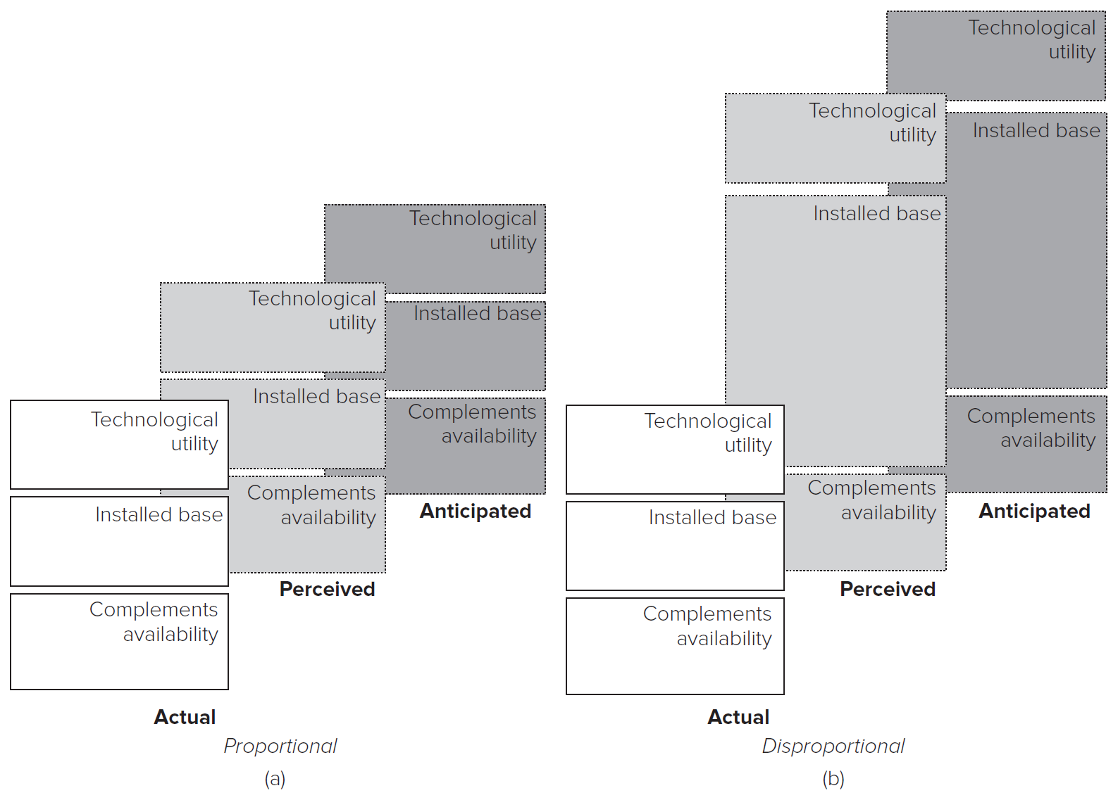
Multiple Dimensions of Value 7
Subjective information (perceptions and expectations) can matter as much as objective information (actual numbers)
Value attributed to each dimension may be disproportional
Access the text alternative for slide images.

Slide 19
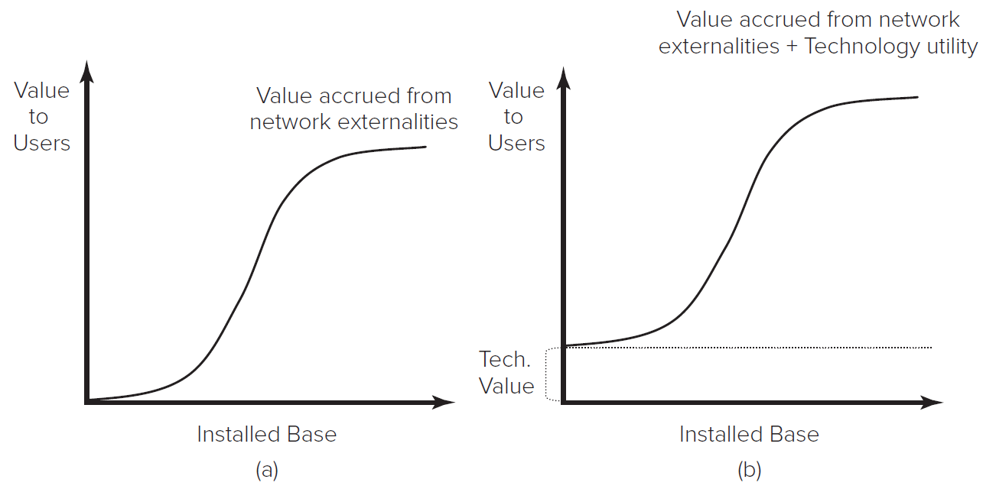
Multiple Dimensions of Value 8
Competing for Design Dominance in Markets with Network Externalities
We can graph the value a technology offers in both standalone value and network externality value:
Access the text alternative for slide images.

Slide 20
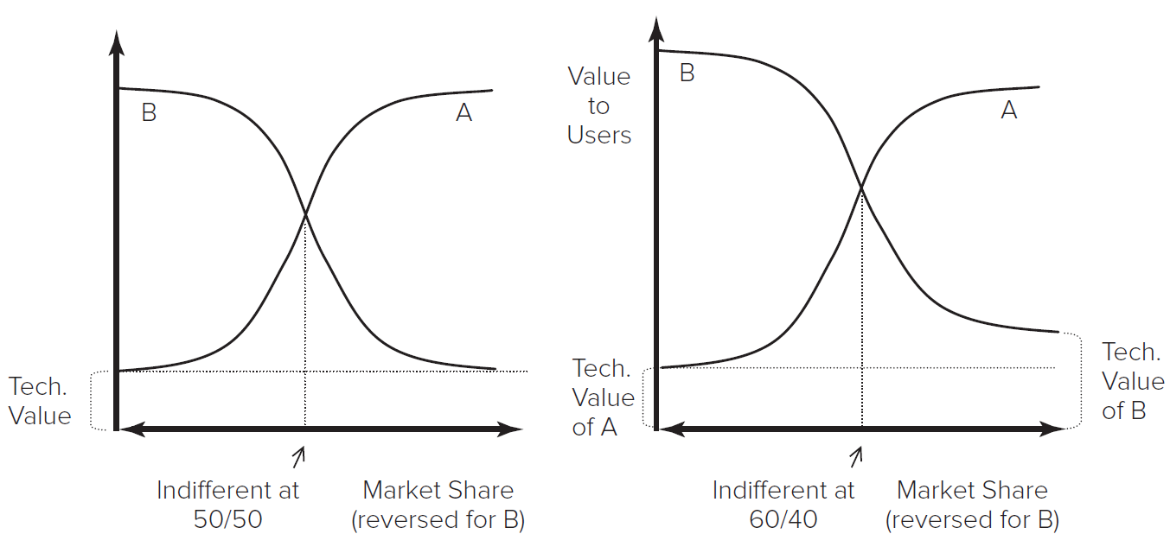
Multiple Dimensions of Value 9
We can compare the graphs of two competing technologies and identify cumulative market share levels (installed base) that determine which technology yields more value.
Access the text alternative for slide images.

Slide 21
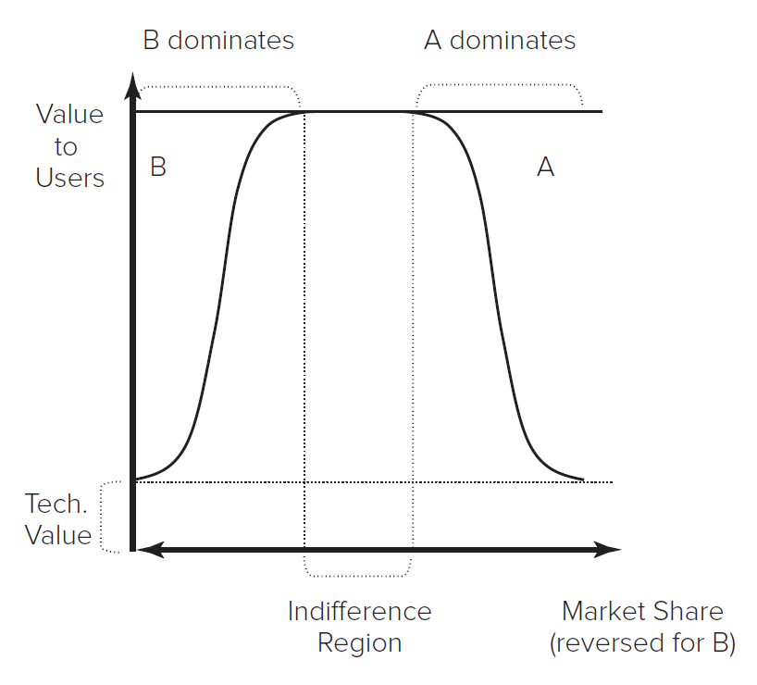
Multiple Dimensions of Value 10
We can compare the graphs of two competing technologies and identify cumulative market share levels (installed base) that determine which technology yields more value.
Access the text alternative for slide images.

Slide 22
Are Winner-Take-All Markets Good for Consumers? 1
Economics emphasizes the benefits of competition.
However, network externalities suggest users sometimes get more value when one technology dominates.
Should the government intervene when network externalities create a natural monopoly?

Slide 23
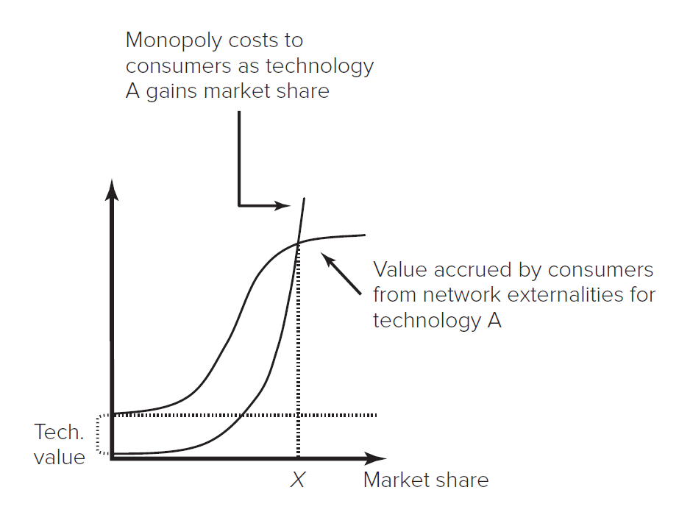
Are Winner-Take-All Markets Good for Consumers? 2
Network externality benefits to customers rise with cumulative market share
Potential for monopoly costs to customers (for example, price gouging, restricted product variety, etc.) also rise with cumulative market share.
Curve shapes are different; Network externality benefits likely to grow logistically, while potential monopoly costs likely to grow exponentially.
Where monopoly costs exceed network externality benefits, intervention may be warranted. Optimal market share is at point where lines cross.
Access the text alternative for slide images.

Slide 24
Modularity and Platform Competition 1
In some markets, industry players use modularity to create a platform ecosystem where many different firms contribute to the product system.
Modular systems are those that can be separated and recombined to change their configuration, scale, or functions.
Standardized interfaces ensure that components are compatible.
In some product systems modularity enables components from different producers to be recombined (for example, smartphones with different apps); in others only components from a single firm are recombined (for example, Ikea shelving systems).
Modularity is more valuable when there are a) diverse technological options that can be recombined, and b) customers have heterogeneous preferences.

Slide 25
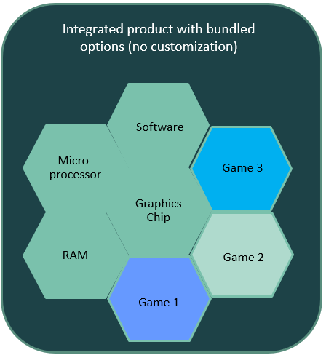
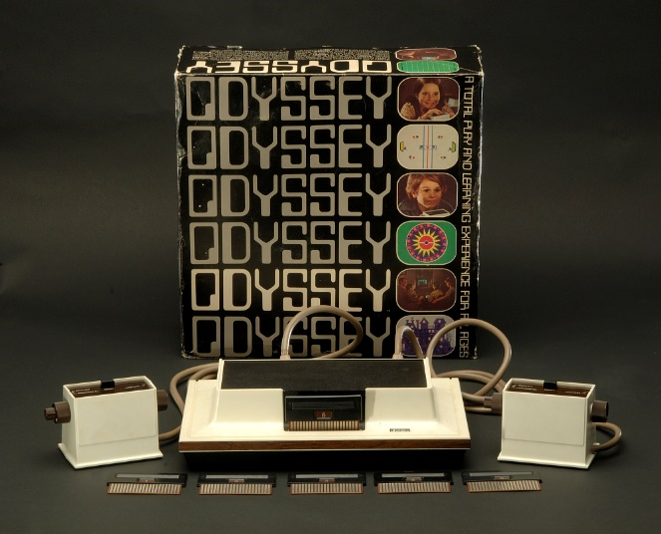
Modularity and Platform Competition 2
Traditional integrated product bundle:
Provider tries to meet buyers needs itself.
No customization, no external compatibility.
Access the text alternative for slide images.

Slide 26
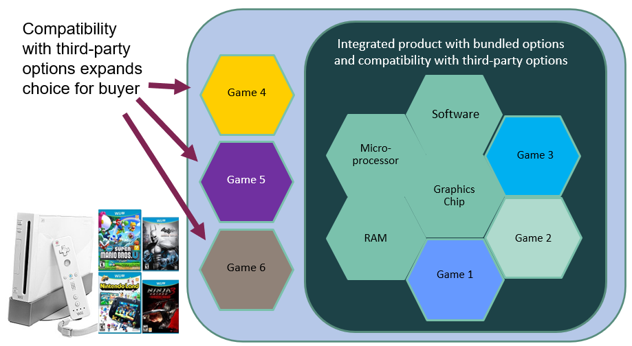
Modularity and Platform Competition 3
Access the text alternative for slide images.

Slide 27
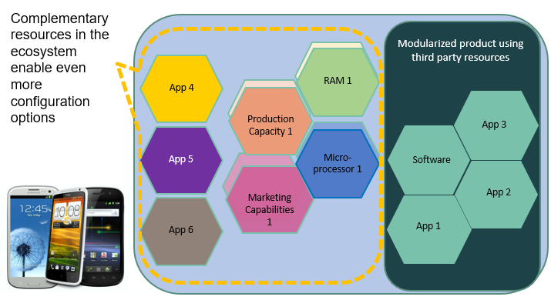
Modularity and Platform Competition 4
Access the text alternative for slide images.

Slide 28
Platform Ecosystems
In a platform ecosystem, some core part of a product (such as a video game console) mediates the relationship between a wide range of other components or complements (for example, video games, peripherals) and prospective end-users.
A platform’s boundaries can be well-defined with a stable set of members or amorphous and changing.
The success of all members of the ecosystem depends in part upon the success of other members.
Members often invest in co-specialization or exclusivity agreements.

Slide 29
Platform ecosystems strike a balance between pure modularity and pure integration
Pure Modularity
Combinations take place in the market – no co-specialization
Choice and reconfigurability Competition incentivizes firms to increase quality and decrease price
Quality and compatibility is uncertain (can be hard for customer)
Platforms
Components not owned, but curated.
Choice and reconfigurability, but shepherded by platform sponsor
Competition still incentivizes
Producer exerts some control over quality and compatibility
Pure Integration
Combination pre-determined by firm (no reconfiguration)
Captive supply (no competition)
High co-specialization ensures components optimized to work together
Producer controls quality and compatibility

Slide 30
Discussion Questions
What are some of the sources of increasing returns to adoption?
What are some examples of industries not mentioned in the chapter that demonstrate increasing returns to adoption?
What are some of the ways a firm can try to increase the overall value of its technology, and its likelihood of becoming the dominant design?
What determines whether an industry is likely to have one or a few dominant designs?
Are dominant designs good for consumers? Competitors? Complementors? Suppliers?
In what kinds of industries will platform ecosystems be more valuable than pure modularity or integrated hierarchies?

Slide 31
Supplemental Video
Two short videos on
Innovation Strategy: Network Externalities
https://youtu.be/CIp7TR2R4gg
Innovation Strategy: Platform Ecosystems
https://youtu.be/J0kdOlqgF6E

Slide 32
End of Main Content
© McGraw Hill LLC. All rights reserved. No reproduction or distribution without the prior written consent of McGraw Hill LLC.

Slide 33
Accessibility Content: Text Alternatives for Images

Slide 34
Why Dominant Designs Are Selected 1 – Text Alternative
Return to parent-slide containing images.
The first graph illustrates a decrease in the cost per unit corresponding to an increase in cumulative output. The second graph illustrates an increase in the performance on each unit corresponding to an increase in cumulative output.
Return to parent-slide containing images.

Slide 35
Why Dominant Designs Are Selected 4 – Text Alternative
Return to parent-slide containing images.
In this cycle, the two factors complement each other. A large installed base attracts producers of complementary goods. The availability of complementary goods attracts users, which in turn increases the installed base.
Return to parent-slide containing images.

Slide 36
Multiple Dimensions of Value 6 – Text Alternative
Return to parent-slide containing images.
Technological utility, installed base, and availability of complementary goods are components that determine the value of technology. Existing technology is considered valuable if it contains a stand-alone technological utility, an installed base, and complementary goods. New technology competes only on the value of its stand-alone utility. For a new technology to be considered valuable, its technological utility should be able to eclipse the combined value of the technological utility, installed base, and complementary goods availability of an existing technology. This provides a marginal value increase for the new technology when compared to the existing technology. When the new technology is compatible with existing technology's installed base and complementary goods, a moderate value of technological utility may be able to help attain a marginal value increase for the new technology when compared to the existing technology.
Return to parent-slide containing images.

Slide 37
Multiple Dimensions of Value 7 – Text Alternative
Return to parent-slide containing images.
Perception of technology is proportional when the perceived and anticipated value components of the technology match its actual value components. Perception of technology is disproportional when one or more perceived value components and/or anticipated value components do not match actual value components.
Return to parent-slide containing images.

Slide 38
Multiple Dimensions of Value 8 – Text Alternative
Return to parent-slide containing images.
There are two graphs that are labeled “a” and “b.” The x-axes of both graphs represent installed base, and the y-axes represent value to users. The graph labeled “a” illustrates the following: The value of technology increases at a slow pace initially. As the installed base increases, the value to users increases exponentially, continues at a steady rate of increase, and then reaches a plateau after which the value does not change. The graph labeled “b” illustrates the following: The value of technology increases at a slow pace initially. As the installed base increases, the value to users increases exponentially, continues at a steady rate of increase, and then reaches a plateau after which the value does not change. The value of technology illustrated in graph “b” is greater than that of graph “a.” This is because the value of technology in graph “b” is bolstered by technological utility. Hence, though the progression of value is identical in both graphs, the overall value is greater in graph “b.”
Return to parent-slide containing images.

Slide 39
Multiple Dimensions of Value 9 – Text Alternative
Return to parent-slide containing images.
In both graphs, the network externality returns curves for technologies A and B are plotted opposing each other. Because of this, the x-axes are bidirectional. The x-axes represent market share, and the y-axes represent value to users. In the first graph, the externality returns curves for technologies A and B are equal and they oppose each other. This illustrates the following: When technology A possesses less than 50 percent of market share, technology B will possess more than 50 percent, making technology B more attractive to customers. When technology B possesses less than 50 percent of market share, technology A will possess more than 50 percent, making technology A more attractive to customers. When market share is split between both technologies evenly, customers will be indifferent toward both of them. These factors hold true as long as the technological value of A and B are the same. In the second graph, the externality returns curve of B is higher than that of A as the technological value of B is greater than that of A. Because of this, the market is indifferent toward both technologies at a point when technology A possesses 60 percent of market shares, and technology B possesses 40 percent.
Return to parent-slide containing images.

Slide 40
Multiple Dimensions of Value 10 – Text Alternative
Return to parent-slide containing images.
The network externality returns curves for technologies A and B are plotted opposing each other. Because of this, the x-axis is bidirectional. The x-axis represents market share, and the y-axis represents value to users. The graph illustrates that the curves flatten out sooner, implying that the maximum amount of network externality value is obtained by customers at low levels of market share. The indifference region within which neither technology dominates the market is large.
Return to parent-slide containing images.

Slide 41
Are Winner-Take-All Markets Good for Consumers? 2 – Text Alternative
Return to parent-slide containing images.
The x-axis of the graph represents market share. The y-axis is not labeled. There are two curves. One is a typical network externality returns curve, which illustrates the increase in the value of technology A to customers as market share increases. The other curve illustrates the increase in monopoly costs to customers as market share increases. According to the graph, at a market share of X, the monopoly cost to customers is equal to the value that consumers accrue from network externalities. If the market share exceeds X, the monopoly cost is higher than the value accrued. As long as the market share is less than X, the value accrued outweighs the cost.
Return to parent-slide containing images.

Slide 42
Modularity and Platform Competition 2 – Text Alternative
Return to parent-slide containing images.
The figure titled integrated product with bundled options (no customization) shows a hexagon at the centre with 6 hexagons adjacent to it sides. The hexagon at the centre is marked graphics chip. The hexagon on top is marked software. The hexagon on the top right is marked game 3. The hexagon at the bottom right is marked game 2. The hexagon at the bottom is marked game 1. The hexagon at the bottom left is marked R A M. The hexagon on the top left is marked micro-processor.
Return to parent-slide containing images.

Slide 43
Modularity and Platform Competition 3 – Text Alternative
Return to parent-slide containing images.
The figure on the left shows 3 hexagons arranged one on top of the other. The hexagon on the top is marked game 4. The hexagon in the middle is marked game 5. The hexagon at the bottom is marked game 6. On the top left is the following caption with 3 arrows pointing to the 3 hexagons: compatibility with third-party options expands choice for buyer. On the right is a figure titled integrated product with bundled options and compatibility with third-party options which shows a hexagon at the centre with 6 hexagons adjacent to it sides. The hexagon at the centre is marked graphics chip. The hexagon on top is marked software. The hexagon on the top right is marked game 3. The hexagon at the bottom right is marked game 2. The hexagon at the bottom is marked game 1. The hexagon at the bottom left is marked R A M. The hexagon on the top left is marked micro-processor.
Return to parent-slide containing images.

Slide 44
Modularity and Platform Competition 4 – Text Alternative
Return to parent-slide containing images.
The figure titled complementary resources in the ecosystem enable even more configuration options shows 3 hexagons arranged on one top of the other. The hexagon at the top is marked app 4. The hexagon in the middle is marked app 5. The hexagon at the bottom is marked app 6. The figure on the right shows 2 hexagons on the right, one on top of the other. The hexagon on the top right contains 2 hexagons with the above hexagon marked R A M 1. The hexagon below contains 2 hexagons, the hexagon above is marked micro-processor 1. Adjacent to the bottom left side of the hexagon top are 2 more hexagons with the hexagon on to marked production capacity 1. Adjacent to the bottom left side of the hexagon below are 2 hexagons with the hexagon above marked marketing capabilities 1. The figure on the right titled modularized product using third party resources contains 4 adjacent hexagons. 2 hexagons are placed one above the other and 2 hexagons are adjacent to the hexagons on the left. The hexagon on the top right is marked app 3. The hexagon below is marked app 2. The hexagon at the bottom left of the hexagon on the top is marked software. The hexagon below is marked app 1.
Return to parent-slide containing images.

